Slide 1

Sales Analysis
Data Exploration

Slide 2
Agenda
Introduction
Data exploration
Interpretation

Slide 3
INTRODUCTION
The data is found in Kaggle and is collected from an Indian e-commerce website.
It consists of 3 CSV files: List of orders, orders details, and Sales Target.
Our objective is to explore the data sets using SQL and Tableau.

Slide 4
INTRODUCTION
We will answer the following questions :
Which category of products is more profitable for the company?
What is the most sold product?
What are the most profitable states?
What are the most valuable customers?
Is the company able to meet the sales Target?

Slide 5
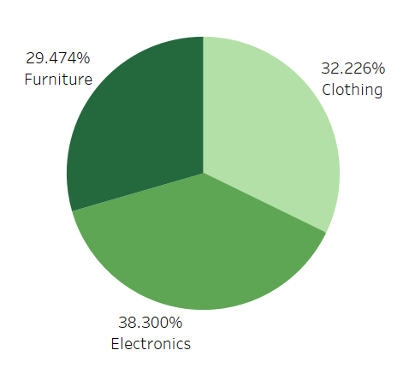
Data Exploration
Overall, the products categories generate more than 25 % of the profit.
The Electronics devices are the most profitable products for the company by representing 38% of the profit.

Slide 6
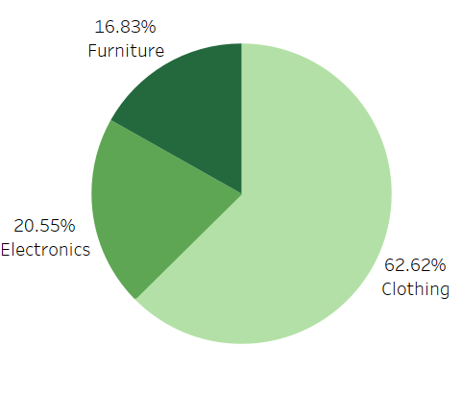
Data Exploration
There is a huge gap between the quantities demanded of the products category. The reason could be that clothes are relatively cheaper than furniture or Electronics.
The clothing items are the favorite products with more than 60% of the total quantity demanded.

Slide 7
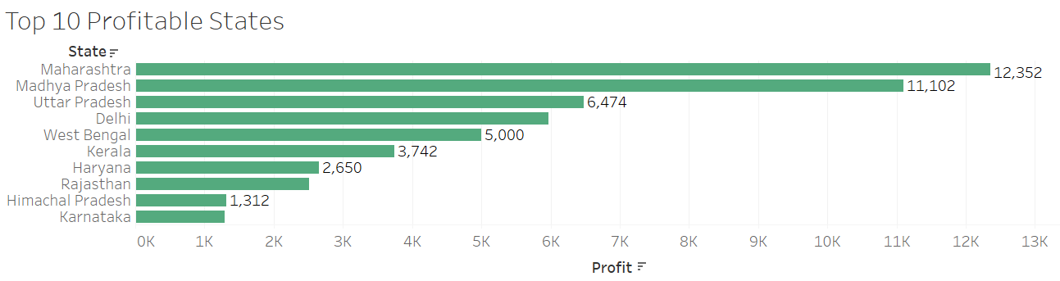
Data Exploration
By far, Maharashtra and Madhya Pradesh are the most profitable state for the e-commerce company.
The sum of their profits represents 48,95 % of the total profit.

Slide 8
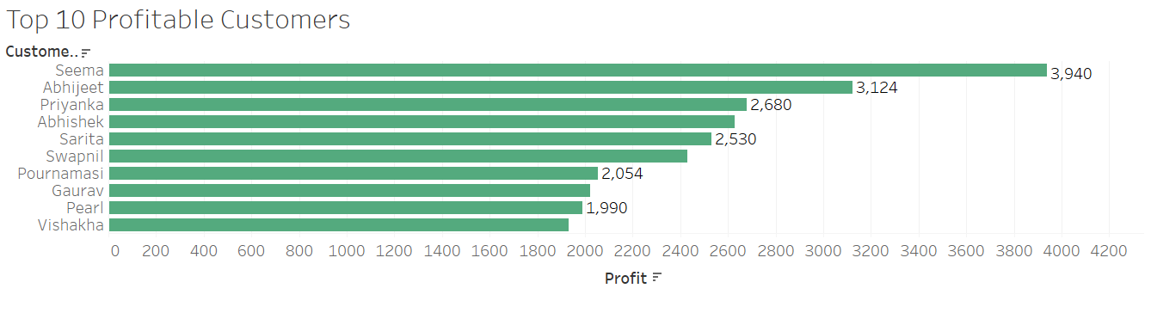
Data Exploration
Seema is the most profitable customer for the business.
The Top 10 customers represent 52,87% of our total profits.

Slide 9
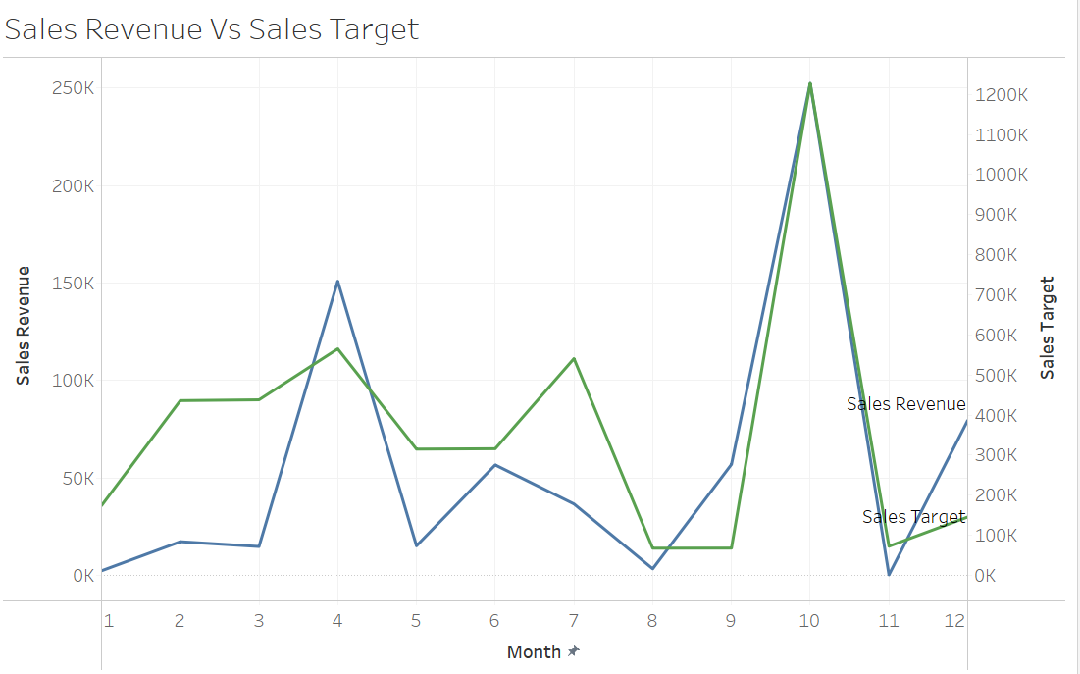
Data Exploration
The sales target is not met for most of the month.
April, September, and December are the months where the sales revenue exceeds the sales Target
There is a pick of the sales in April and December.

Slide 10
Interpretation
Electronics devices are the most profitable product category. Only 20,55% of the quantity purchased represents 60% of the profits.
Maharashtra and Madhya generate almost half of the profit. The marketing strategy should put more emphasis on these cities.
Seema is the best customer.
April, September, and December are the most lucrative months. There is a need to understand if the company offers more discounts or promotions during those months.

Slide 11
Appendix
https://www.kaggle.com/benroshan/ecommerce-data
https://github.com/Anabelleossey/Portfolio

